Slide 1
Section 5.2
One-to-One Functions;
Inverse Functions
Copyright © 2012 Pearson Education, Inc. Publishing as Prentice Hall.

Slide 2
Copyright © 2012 Pearson Education, Inc. Publishing as Prentice Hall.

Slide 3
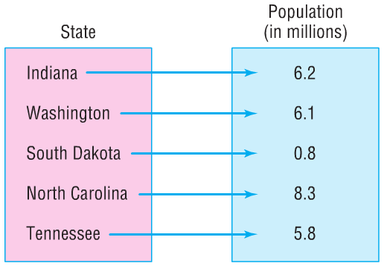
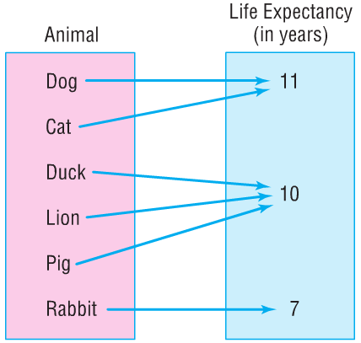
Copyright © 2012 Pearson Education, Inc. Publishing as Prentice Hall.

Slide 4

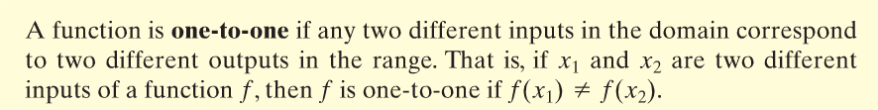
Copyright © 2012 Pearson Education, Inc. Publishing as Prentice Hall.

Slide 5
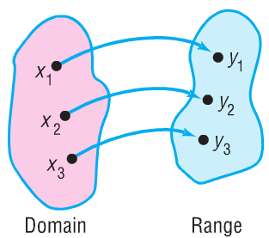
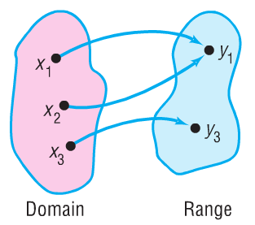
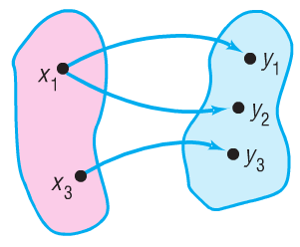
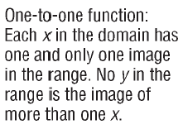


Copyright © 2012 Pearson Education, Inc. Publishing as Prentice Hall.

Slide 6

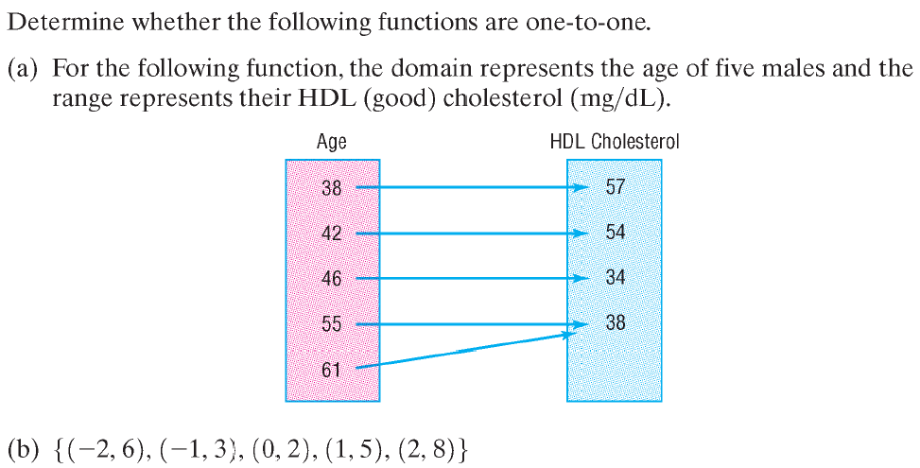
This function is not one-to-one because two different inputs, 55 and 62, have the same output of 38.
This function is one-to-one because there are no two distinct inputs that correspond to the same output.
Copyright © 2012 Pearson Education, Inc. Publishing as Prentice Hall.

Slide 7

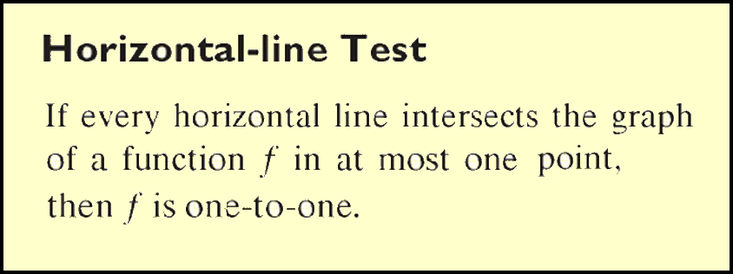
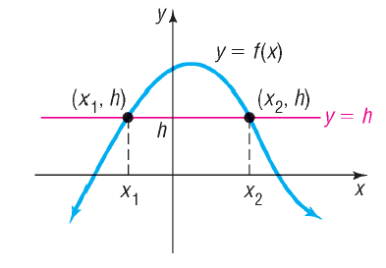

Copyright © 2012 Pearson Education, Inc. Publishing as Prentice Hall.

Slide 8
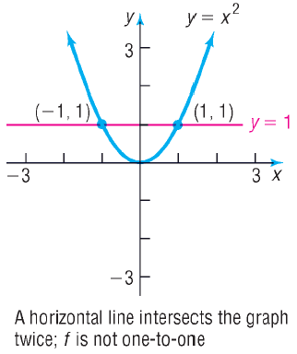
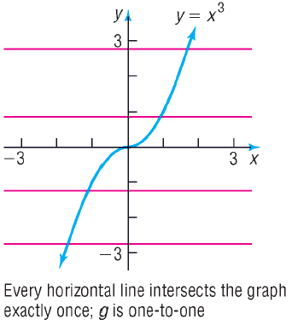
For each function, use the graph to determine whether the function is one-to-one.
Copyright © 2012 Pearson Education, Inc. Publishing as Prentice Hall.

Slide 9
A function that is increasing on an interval I is a one-to-one function in I.
A function that is decreasing on an interval I is a one-to-one function on I.
Copyright © 2012 Pearson Education, Inc. Publishing as Prentice Hall.

Slide 10
Copyright © 2012 Pearson Education, Inc. Publishing as Prentice Hall.

Slide 11

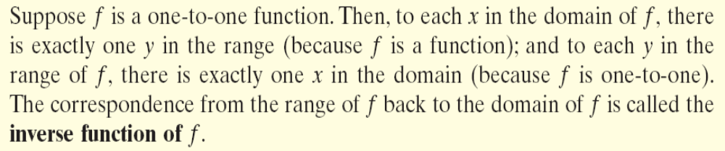
Copyright © 2012 Pearson Education, Inc. Publishing as Prentice Hall.

Slide 12
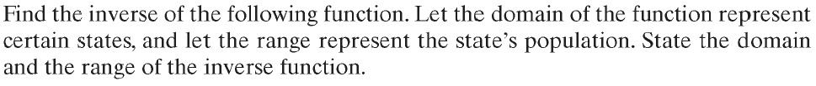
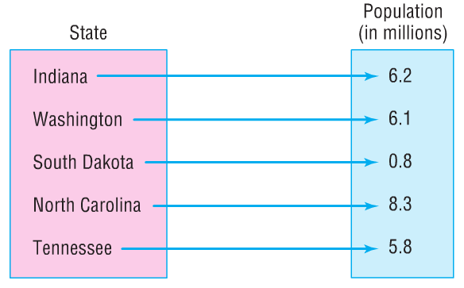
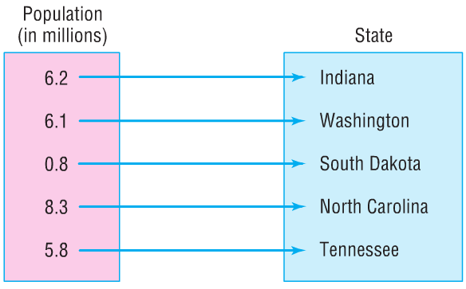
To find the inverse we interchange the elements of the domain with the elements of the range.
The domain of the inverse function is {0.8, 5.8, 6.1, 6.2, 8.3}.
The range of the inverse function is {Indiana, Washington, South Dakota, North Carolina, Tennessee}.
Copyright © 2012 Pearson Education, Inc. Publishing as Prentice Hall.

Slide 13

Find the inverse of the following one-to-one function:
{(-5,1),(3,3),(0,0), (2,-4), (7, -8)}
State the domain and range of the function and its inverse.
The inverse is found by interchanging the entries in each ordered pair:
{(1,-5),(3,3),(0,0), (-4,2), (-8,7)}
The domain of the function is {-5, 0, 2, 3, 7}.
The range of the function is {-8, -4, 0 ,1, 3). This is also the domain of the inverse function.
The range of the inverse function is {-5, 0, 2, 3, 7}.
Copyright © 2012 Pearson Education, Inc. Publishing as Prentice Hall.

Slide 14
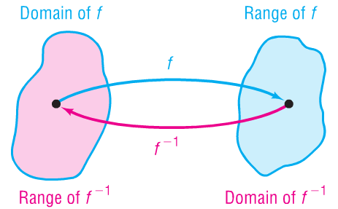

Copyright © 2012 Pearson Education, Inc. Publishing as Prentice Hall.

Slide 15
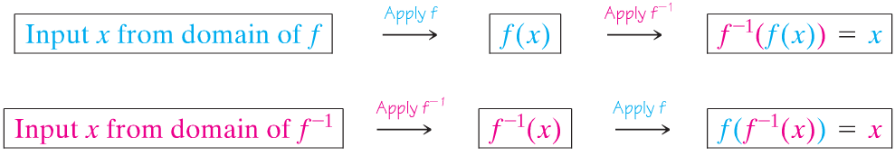
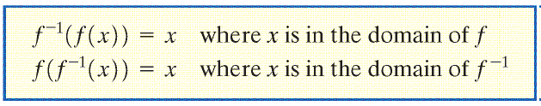
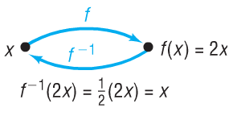
Copyright © 2012 Pearson Education, Inc. Publishing as Prentice Hall.

Slide 16
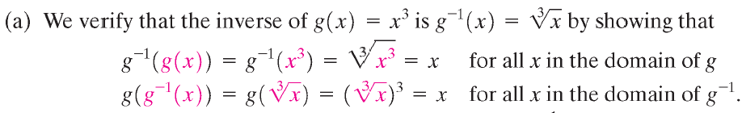
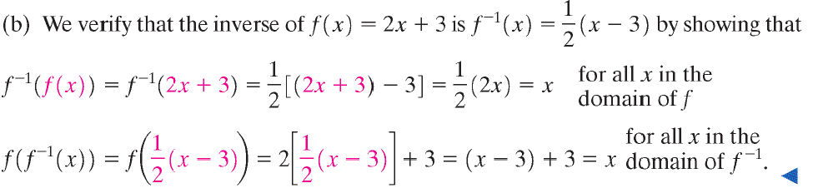
Copyright © 2012 Pearson Education, Inc. Publishing as Prentice Hall.

Slide 17
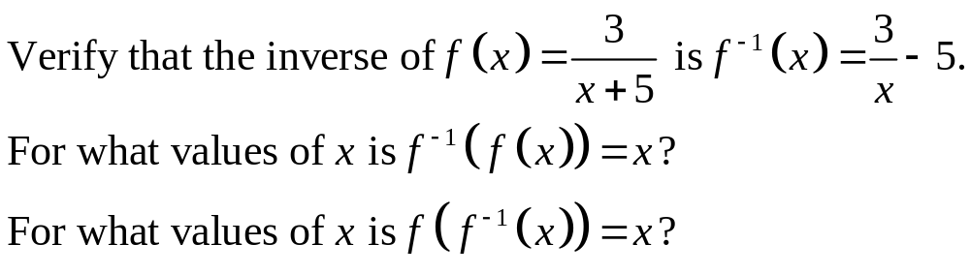
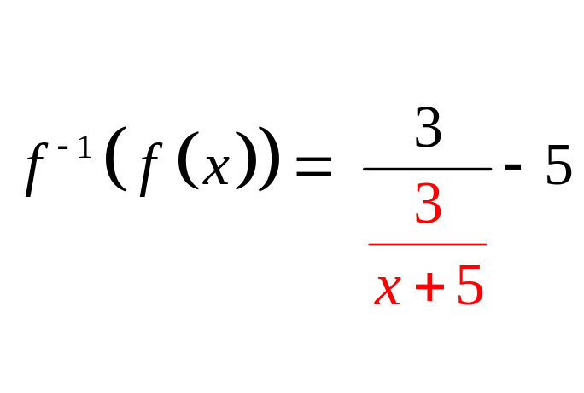
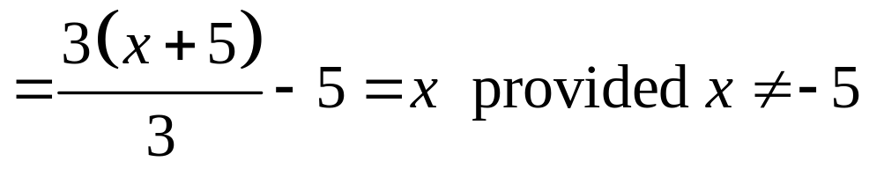
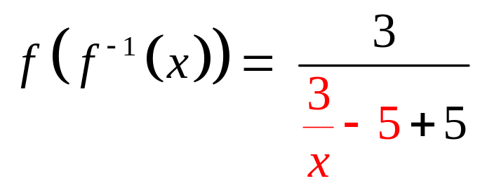
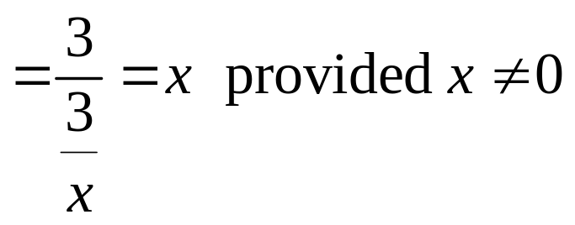
Copyright © 2012 Pearson Education, Inc. Publishing as Prentice Hall.

Slide 18
Copyright © 2012 Pearson Education, Inc. Publishing as Prentice Hall.

Slide 19
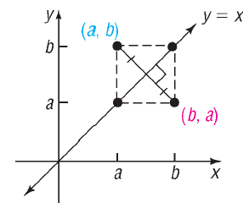

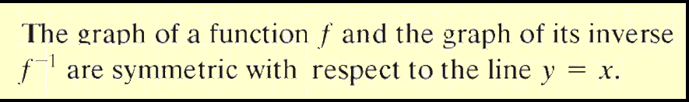
Copyright © 2012 Pearson Education, Inc. Publishing as Prentice Hall.

Slide 20
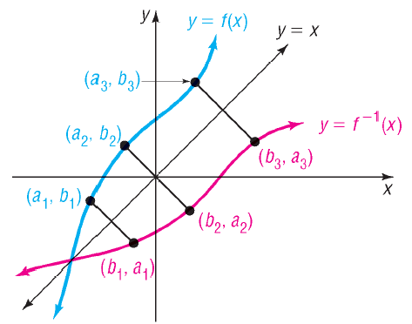
Copyright © 2012 Pearson Education, Inc. Publishing as Prentice Hall.

Slide 21
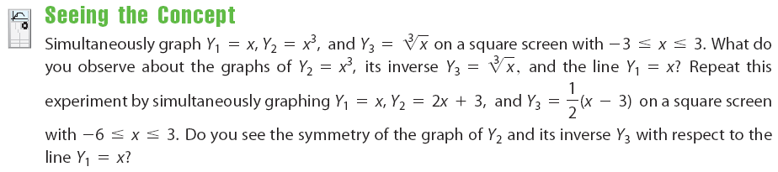


Copyright © 2012 Pearson Education, Inc. Publishing as Prentice Hall.

Slide 22
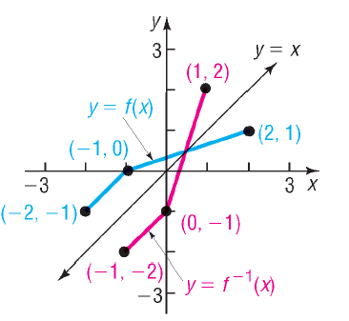
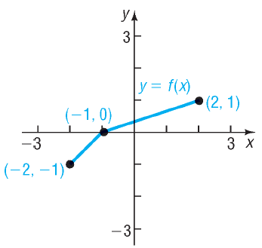
Figure 16(a)
Copyright © 2012 Pearson Education, Inc. Publishing as Prentice Hall.

Slide 23
Copyright © 2012 Pearson Education, Inc. Publishing as Prentice Hall.

Slide 24
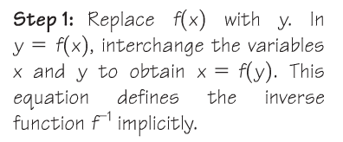
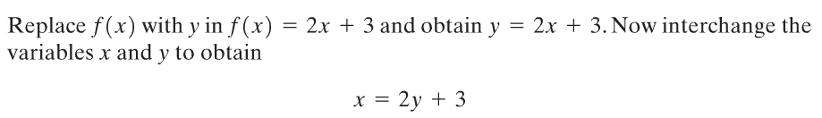
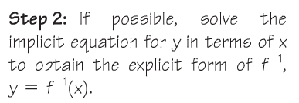




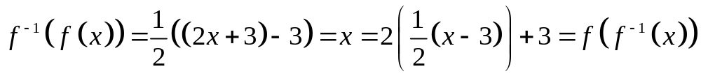
Copyright © 2012 Pearson Education, Inc. Publishing as Prentice Hall.

Slide 25
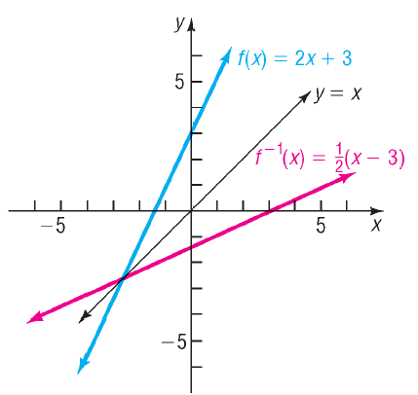
Copyright © 2012 Pearson Education, Inc. Publishing as Prentice Hall.

Slide 26
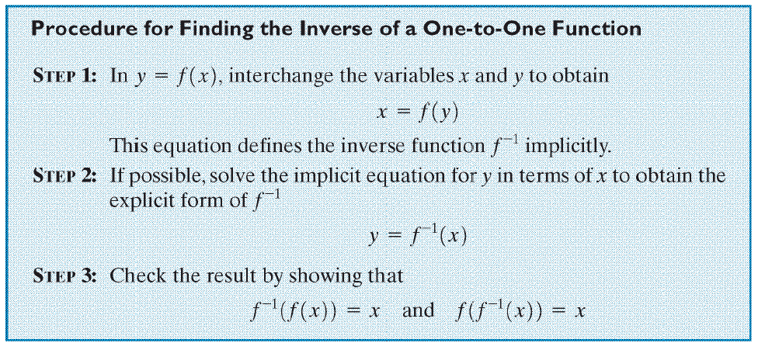
Copyright © 2012 Pearson Education, Inc. Publishing as Prentice Hall.

Slide 27
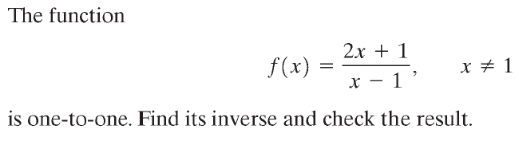
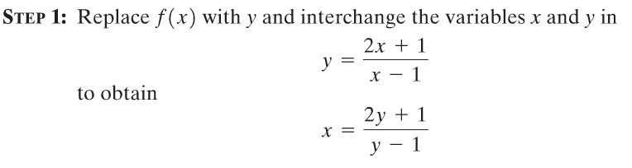







Copyright © 2012 Pearson Education, Inc. Publishing as Prentice Hall.

Slide 28

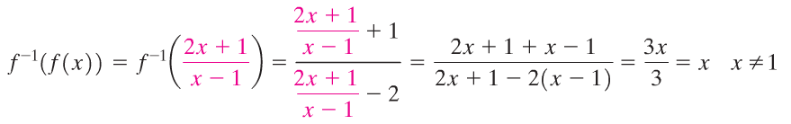
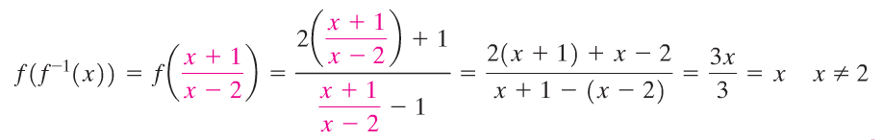
Copyright © 2012 Pearson Education, Inc. Publishing as Prentice Hall.

Slide 29

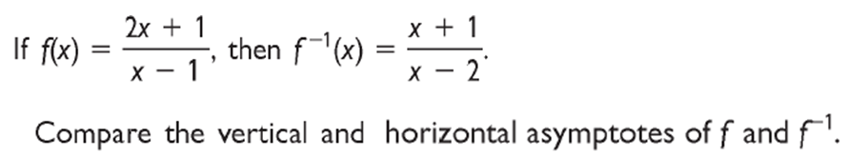




Copyright © 2012 Pearson Education, Inc. Publishing as Prentice Hall.

Slide 30

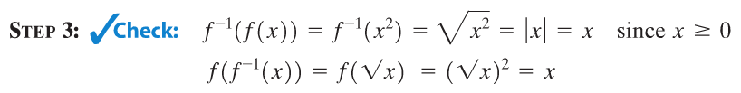
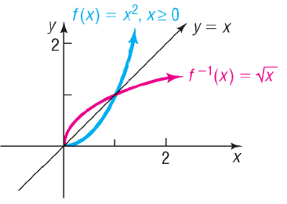
Copyright © 2012 Pearson Education, Inc. Publishing as Prentice Hall.

Slide 31
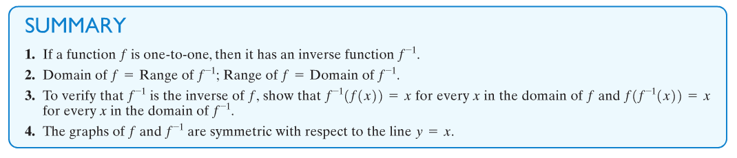
Copyright © 2012 Pearson Education, Inc. Publishing as Prentice Hall.

